Slide 1
SpringBoard Data Science Capstone Project I
Predicting Bankruptcy Possibility of Emerging Business
Dan Wang
May 5th, 2020

Slide 2
Contents
1. Introduction
2. Data Pre-processing
3. Data Storytelling
4. Models
5. Model Comparisons

Slide 3
Introduction
My project here tries to utilize machine learning algorithms to make predictions on bankruptcy according to current business financial ratios.
Banker and investors are my clients since finding out highly bankruptcy business is the key successor for their business.

Slide 4
Data Pre-processing
Get Column Names from Website
https://archive.ics.uci.edu/ml/datasets/Polish+companies+bankruptcy+data
Python Libraries Utilized:
Request Library
BeautifulSoup Library

Slide 5
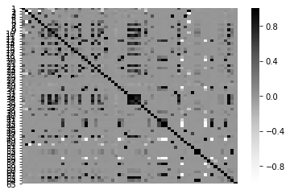
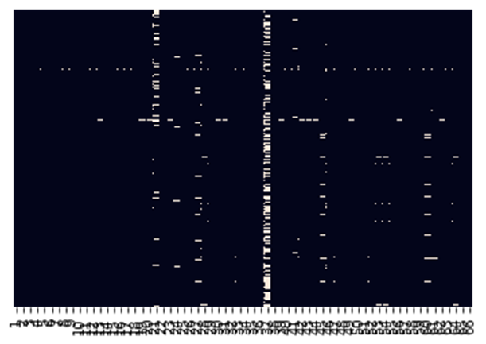
Data Pre-processing
Handle Missing Values
Techniques Utilized
Pearson’s Correlation Coefficient
Heat map
Thread hold: 0.9
Column thread hold: 2,000
Row thread hold: 10

Slide 6
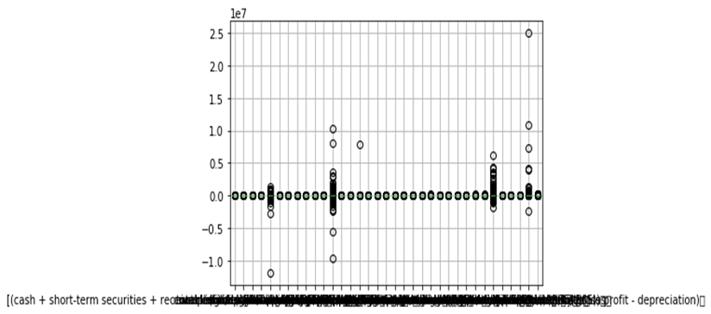
Data Pre-processing
Identify and Remove Outliers
Techniques Utilized
Box Plot
Percentile (5th and 95th)
Thread hold: less than 5th percentile
or: greater than 95th percentile

Slide 7
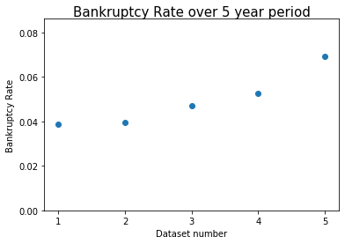
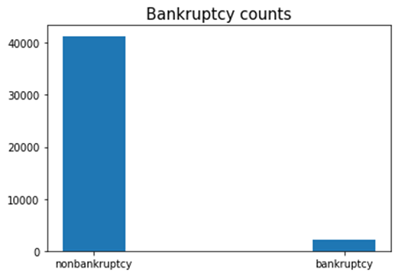
Data Storytelling
Bankruptcy Rate Over the 5 Year Period
First two year around 4%
Start to increase at 3rd and reach 7% at 5th year
Data Structure
4%~7% Bankruptcy VS 93%~96% non-bankruptcy
Imbalanced Dataset—upsampling to 1:1

Slide 8
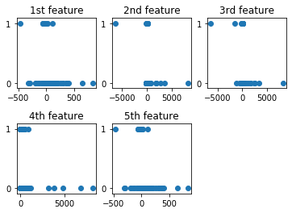
Data Storytelling
Feature Selection
SelectKBest (chi-square method)
Dataset rescaling (normalization)
Features Selected:
(gross profit + depreciation) / total liability
(net profit + depreciation) / total liabilities
gross profit / short-term liabilities
book value of equity / total liabilities
gross profit (in 3 years) / total assets

Slide 9
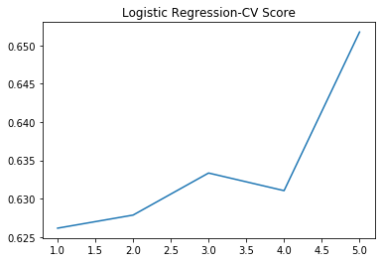
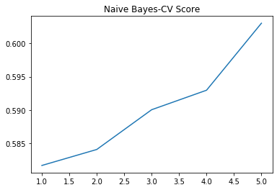
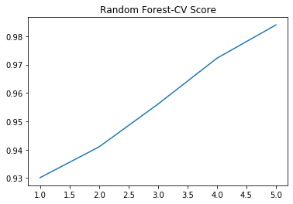
Models
Logistic Regression
Gaussian Naïve Bayes
Random Forest

Slide 10
Model Comparison
Model Selected: Random Forest

